Slide 1














Pix2Pix GAN: Coloring images
Presented by
Manan Gadhiya
Suyash Patil
Aditya Ubale

Slide 2
Introduction
In the computer vision and image processing, the task of automatically adding color to grayscale images has long been a challenge. Recent advancements in Generative Adversarial Networks (GANs) have revolutionized this field by enabling sophisticated image-to-image translation tasks.
The aim of this project is to implement a Pix2Pix GAN model using deep learning techniques to automatically colorize grayscale images.
The Pix2Pix GAN architecture consists of a generator network that generates colorized images from grayscale inputs, and a discriminator network that learns to differentiate between real color images and generated colorized images.

Slide 3
Objective & Societal Impact
Technical Objectives:
Implement a Pix2Pix GAN model architecture suitable for converting grayscale images to colorized versions.
Train the model using a curated dataset of paired grayscale and color images, optimizing for color fidelity and realism.
Evaluate and refine the model to achieve high-quality colorization results, minimizing artifacts and improving perceptual quality metrics.
Societal Impact Objectives:
Educational Applications:
Facilitate educational materials by providing colorized visuals in textbooks, documentaries, and online resources, enhancing comprehension and engagement.
Healthcare Impact:
Assist medical professionals in analyzing medical imagery by adding color to grayscale scans, potentially improving diagnostic accuracy and patient care.

Slide 4
Methodology
1.Dataset Preparation:
Collect and preprocess a dataset of grayscale images paired with corresponding color images.
Resize images to a consistent resolution and normalize pixel values.
Model Development:
Design a Pix2Pix GAN architecture comprising a generator and discriminator network.
Implement the generator to convert grayscale images into colorized versions.
Training:
Train the Pix2Pix GAN model using the prepared dataset
Testing and Deployment:
Test the trained model on new grayscale images to generate colorized outputs.
Deploy the model for practical applications such as batch processing or real-time colorization.

Slide 5
Algorithm
Input:
Grayscale images (X) paired with corresponding color images (Y).
Initialize:
Define the architecture of the Pix2Pix GAN model:
G: Generator network to convert grayscale images (X) to colorized images .
D: Discriminator network to distinguish between real color images
and generated colorized images

Slide 6
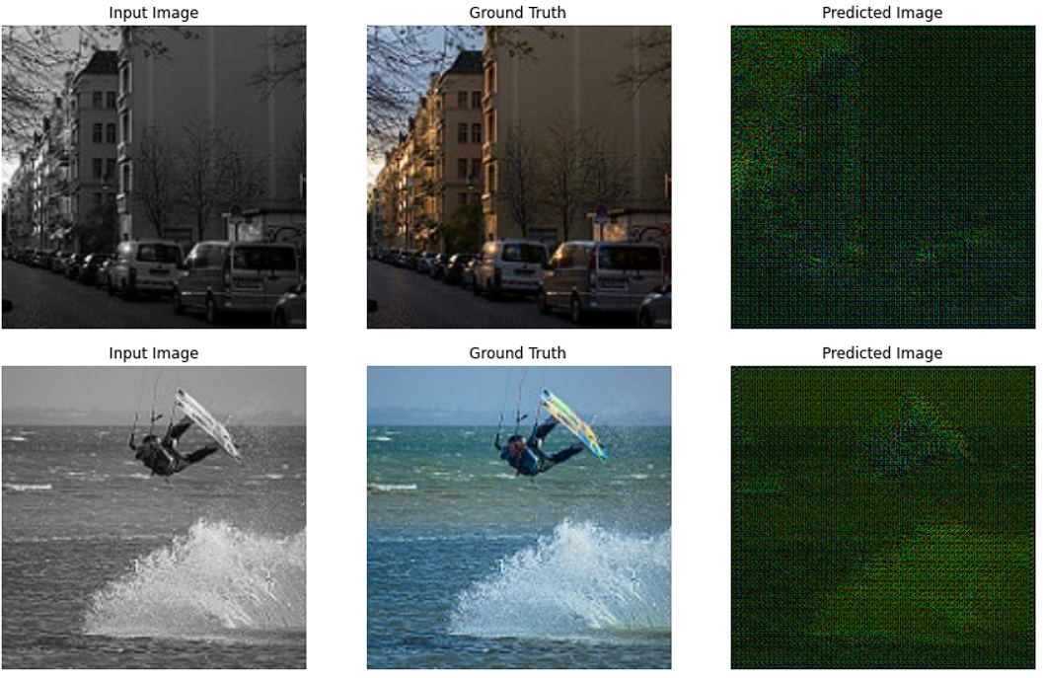
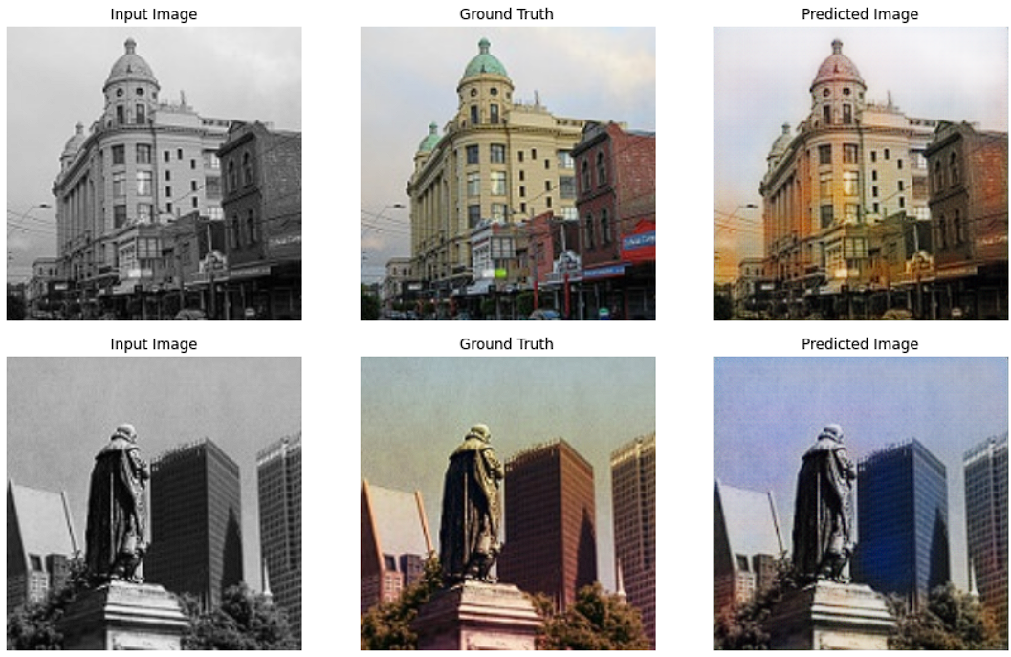
RESULT

Slide 7
CONCLUSION
In this project, we successfully developed and trained a Pix2Pix GAN model to perform image colorization, converting grayscale images into realistic and visually appealing colorized versions. The implementation involved several critical steps, including dataset preparation, model architecture design, training, evaluation, and deployment
our Pix2Pix GAN image colorization project showcases the power of deep learning in image-to-image translation tasks, demonstrating promising results in generating realistic colorizations from grayscale inputs. The project opens avenues for further research and applications in computer vision, fostering innovation and impact across various domains.

Slide 8
TOOLS
1.TENSORFLOW
A popular open-source deep learning library developed by Google. TensorFlow provides high-level APIs (e.g., Keras) for building and training neural networks, making it suitable for implementing Pix2Pix GAN models.
2.PYTORCH
Another widely used deep learning framework with dynamic computational graphs. PyTorch offers flexibility and ease of use, making it a preferred choice for research and development in computer vision tasks.
3.OPEN CV
A library for image processing and computer vision tasks. OpenCV is used for reading, preprocessing, and augmenting images in preparation for training Pix2Pix GAN models.

Slide 9
References
TensorFlow Pix2Pix Tutorial:
Tutorial: Image-to-Image Translation with Pix2Pix
PyTorch Pix2Pix Tutorial:
Tutorial: Image-to-Image Translation with Conditional Adversarial Nets (Pix2Pix)
Isola, P., Zhu, J. Y., Zhou, T., & Efros, A. A. (2017). Image-to-Image
Translation with Conditional Adversarial Networks. In Proceedings of the IEEE Conference on Computer Vision and Pattern Recognition (CVPR).

